Slide 1


Exploring Learner Lexicons through NLP Approaches

Slide 2


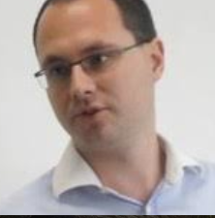






Colleagues involved in SALAT projects
Cindy Berger (DuoLingo)
Joon Choi
(Vanderbilt)
Mihai Dascalu
(Bucharest)
Masaki Eguchi
(U of Oregon)
Scott Jarvis
(U of Utah)
Minkyung Kim
(Korean National)
Kristopher Kyle
(U of Oregon)
Danielle McNamara (ASU)
Katia Monteiro
(GSU)
Fred Zenker
(UHM)

Slide 3
Overview of the talk
Getting started
NLP
SLA and LCR
Lexical sophistication
TAALES/TAALED Tutorial
Getting TAALES working
TAALES/TAALED primary output
TAALES/TAALED fine-grained output
Data analysis
Introduction to dataset

Slide 4



Getting started
To get TAALES working on your computer, please follow the instructions listed on the following webpage:
https://www.linguisticanalysistools.org/taales.html
To get TAALED working on your computer, please follow the instructions listed on the following webpage:
https://www.linguisticanalysistools.org/taaled.html
To get JASP working on your computer, please follow the instructions here
https://jasp-stats.org/

Slide 5

Why this Workshop?
Data Data Data Data Data
It’s everywhere and becoming bigger and grander
Recent examples for learner corpora
TOEFL 11 corpus
12,100 English essays written by speakers of 11 non-English native languages
The EF-Cambridge Open Language Database (EFCAMDAT)
83 million words from 1 million assignments written by 174,000 learners
How to measure elements of language related to complexity, fluency, and accuracy in such large corpora?
Human judgments of these elements are
Time consuming
Subjective
Prone to mistakes

Slide 6

Computational linguistics or NLP?
Mostly interchangeable, but…
Computational linguistics = Science to find new knowledge
Understand capacity for humans to produce and process language
Natural language processing = Engineering to solve problems
Build useful tool to solve linguistic problems
Mix with statistical methods to increase reliability and validity
Fast, powerful, and relatively easy to use

Slide 7



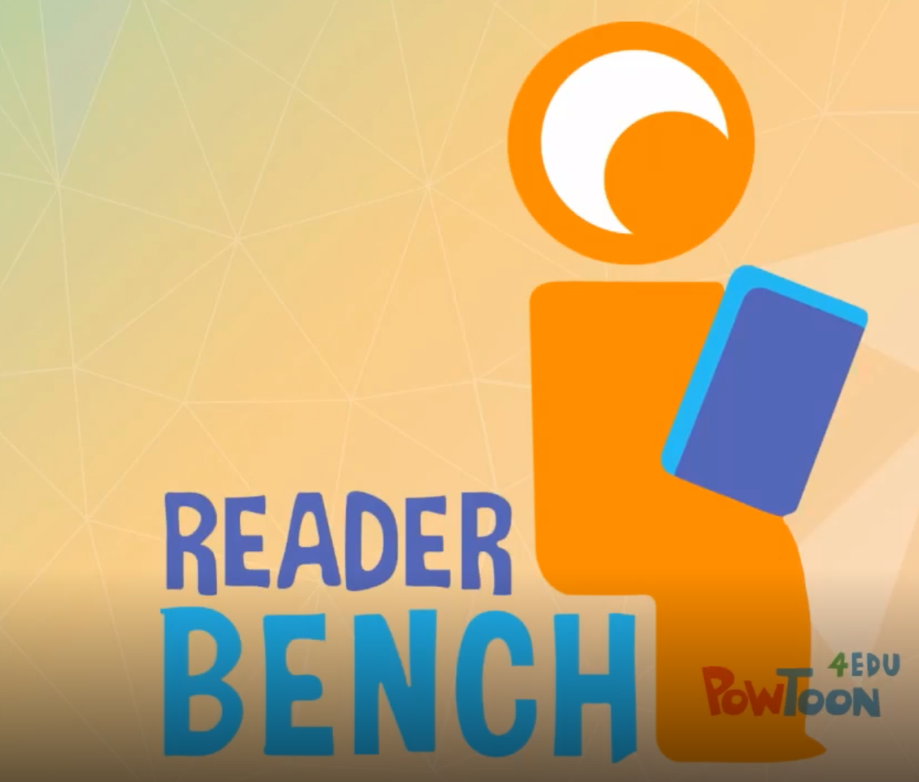





Why NLP?
NLP seems complicated and inaccessible to many researchers
But even simple NLP is extremely powerful
Much research could be enhanced with NLP just by counting the number of words
An easy proxy for fluency in many tasks
Many NLP tools are currently available
Mostly free
Mostly user friendly
Do not require background in computer science
Provide crucial information about the linguistic and language information in texts
Notes:
LCA and L2SCA MAT Coh-Metrix LIWC etc…

Slide 8
SLA and LCR
Second language acquisition (SLA) and learner corpus research (LCR):
Related in that both fields have been interested in topics such as linguistic development
Distinct
SLA grew out of educational psychology (among other fields)
SLA has had a focus on hypothesis testing through controlled studies (with typically small n-sizes)
LCR grew out of corpus linguistics
LCR has tended to use large data sets with less control
LCR has often focused on describing language use by larger populations

Slide 9
SLA and LCR
Second language acquisition (SLA) and learner corpus research (LCR):
Are converging
SLA researchers are beginning to use larger, pre-collected datasets to help address wider research questions
LCR research is becoming more informed by SLA research
Learner corpus compilers are now controlling for a variety of learner variables, enabling questions in SLA to be addressed more clearly
Edited volumes for further reading:
Second Language Acquisition and Learner Corpora (Paquot & LeBruyn, 2019)
Routledge Handbook of SLA & Corpora Tracy-Ventura & Paquot (Spring 2020)

Slide 10
Learner Corpus Research
Learner corpora consist of generally large collections of learner productions. Learner corpora can be categorized based on
L2 (a wide variety, but still predominately English)
L1 (a wide variety)
Mode (spoken, written, online chat)
Natural vs. Structured (free conversation, prompt-based essays, monologues, etc.)
longitudinal vs. cross-sectional
Available metadata (age of onset, proficiency scores, etc.)
The CECL website has an excellent, fairly up to date list of available learner corpora!

Slide 11
Analyzing Linguistic Complexity In Learner Corpora
Learner corpora are unwieldy without automated analysis techniques.
Learner corpus research is mostly confined by these techniques
But, many advancements have been made in the last 10 years
Part of speech tagging
Syntactic annotation
Sentiment analysis
Voice to text
Corpora
Dictionaries

Slide 12
Lexical Richness
Our focus

Slide 13
Lexical Richness
Lexical diversity
(see Jarvis, 2013)
Lexical Sophistication
(see Crossley, Salsbury, McNamara, & Jarvis, 2011a, b; Meara, 1996; Nation, 1990; Read, 2000)
Lexical Density
(see Johansson, 2008; Lu, 2012)

Slide 14

Lexical Diversity
Three simple constructs of lexical diversity (Jarvis, 2013 & 2017)
Volume: number of words in a text
Abundance: total number of different types in a text
Variety: variation in lexical items in a text
Generally operationalized as type-token ratio (TTR)
Simplest and most widely used LD index
TTR = unique words (types) / running words (tokens)

Slide 15
Text Length concerns and TTR
Traditional LD measures sensitive to text length
longer text lengths → lower scores
Problematic because
L2 texts for a given task tend to vary widely in length
Proficiency levels influence production rate
Some revised LD measures more resistant to length effects
D (Malvern & Richards, 1997; McCarthy & Jarvis, 2007)
Moving Average TTR (Covington & McFall, 2010)
Measure of Textual Lexical Diversity (MTLD, McCarthy & Jarvis, 2010)

Slide 16
Remember…
Traditional indices of LD are NOT stable across different texts of different lengths
Variety is only one measure of lexical diversity (Jarvis, 2013a, 2013b, 2016, 2017)
Jarvis, S. (2013a). Capturing the diversity in lexical diversity. Language Learning, 63(s1), 87–106.
Jarvis, S. (2013b). Deﬁning and measuring lexical diversity. In Vocabulary knowledge: Human ratings and automated measures (Vol. 47, p. 13).
Jarvis, S. (2016, April). Corpus-based discoveries in the modeling and measurement of lexical diversity. Paper presented as part of the invited colloquium Connecting corpus linguistics and language assessment at the annual meeting of the American Association for Applied Linguistics (AAAL) 2016, Orlando, Florida, April 9, 2016.
Jarvis, S. (2017). Grounding lexical diversity in human judgments. Language Testing, 34(4), 537–553.

Slide 17
How to measure Lexical Diversity
CLAWS tagger can measure voc-D
There are a few Python packages to measure lexical diversity
lexical-diversity
Lexicalrichness
And an R package or two
Quanteda
koRpus
But these either
Cost money
Require backgrounds in computer science

Slide 18
TAALED
TAALED batch processes files (it will process all files in a folder)
TAALED calculates ~40 indices in 3 categories
TAALED is a desktop application (your data never leaves your computer)

Slide 19
Abundance:
All, content, function words
Volume: All, content, function words
TAALED 1.4
Variety: TTR, Maas, D, MTLD

Slide 20
Abundance:
All, content, function words
Volume: All, content, function words
TAALED 1.4
MAAS: fit the TTR value to a logarithmic curve
Variety: TTR, Maas, D, MTLD

Slide 21
Abundance:
All, content, function words
Volume: All, content, function words
TAALED 1.4
mattr50: 50 word window moving average for TTR
Variety: TTR, Maas, D, MTLD

Slide 22
Abundance:
All, content, function words
Volume: All, content, function words
TAALED 1.4
msttr50: Mean segmental TTR for 50-word non overlapping segments
Variety: TTR, Maas, D, MTLD

Slide 23
Abundance:
All, content, function words
Volume: All, content, function words
TAALED 1.4
hdd42: probability of encountering same token in a random sample of 42 tokens
Variety: TTR, Maas, D, MTLD

Slide 24
Abundance:
All, content, function words
Volume: All, content, function words
TAALED 1.4
mtld: number of word tokens it takes to reach a given TTR value (.720)
Variety: TTR, Maas, D, MTLD

Slide 25
Abundance:
All, content, function words
Volume: All, content, function words
TAALED 1.4
mtld_ma_bi: moving- average approach both backwards and forwards (the bi)
Variety: TTR, Maas, D, MTLD

Slide 26
Abundance:
All, content, function words
Volume: All, content, function words
TAALED 1.4
mtld_ma_wrap: MA approach. final factor calculated by wrapping to beginning text
Variety: TTR, Maas, D, MTLD

Slide 27
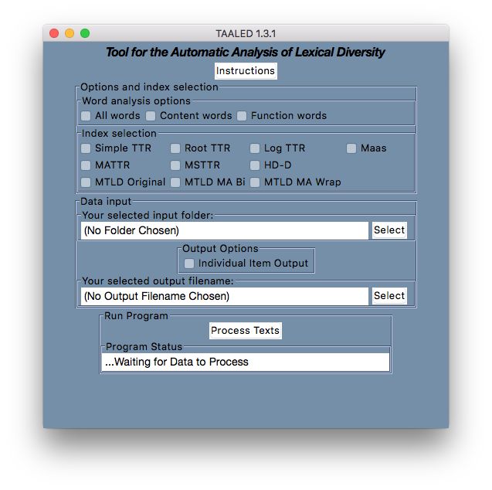

Slide 28
TAALED Processing Pipeline
A set of plain text files are stored in a folder
Files are copied into TAALED and are lemmatized and POS tagged
Lexical diversity calculated
An average index score is calculated for all words, content words, or function words
TAALED outputs a .csv spreadsheet with scores for each index for each text
If desired, TAALED also outputs individual item output

Slide 29
Lexical Sophistication
Lexical sophistication refers to:
the relative difficulty of learning (and therefore using) a word
perceptions of word sophistication (which seems to be related to the concept above)
Hypothesis: More proficient language users will (on average) use more sophisticated words
But what word characteristics make particular words easier/more difficult to learn?

Slide 30
Frequency
Frequency is the most commonly used index of sophistication (and is compatible with most theories of language learning)
Beginning language learners will learn (and therefore use) words that are more frequent in their input*
As they gain language exposure, they will also learn (and use) less frequent words in addition to the more frequent ones*
Either calculated using frequency bands
e.g., VocabProfile; RANGE
More advanced language users will produce a higher percentage of words at lower frequency bands
Or using the average frequency score
e.g., Coh-Metrix; TAALES
more advanced language users will lower frequency words (on average)

Slide 31
Frequency example
Pizza is good.
Pizza is delicious.
Pizza is nutritious.
Pizza 30.6
is 33130.6
good 764.6
mean 11308.6
Pizza 30.6
is (function word)
good 764.6
mean 397.6
Pizza 30.6
is 33130.6
delicious 14.5
mean 11058.6
Pizza 30.6
is (function word) delicious 14.5
mean 22.6
Pizza 30.6
is 33130.6
nutritious 1.6
mean 11054.3
Pizza 30.6
is (function word) nutritious 1.6
mean 16.1

Slide 32
But frequency isn’t everything
Which one of these is more “sophisticated”?
unemployment
intonation
What about these?
intonation
eggshell
And these?
beginning
coalition
unemployment: 3137 instances in COCA newspaper (36.16 per million words)
intonation: 42 instances in COCA newspaper (.47 per million words)
intonation: 42 instances in COCA newspaper (.47 per million words);
concreteness of 2.46
eggshell: 42 instances in COCA newspaper (.47 per million words)
concreteness of 4.77
beginning: frequency of 4784 (54.65 per mill); range of 4320 (8% of docs)
coalition: frequency of 4755 (54.32 per mill); range of 2783 (5% of docs)
Notes:
Brysbaert Concreteness, Scale of 5

Slide 33
So…
Lexical sophistication should be measured in a multivariate, multifaceted manner, NOT using a single index (i.e., frequency)
Crossley, S. A., Kyle, K., & Salsbury, T. (2016). A usage-based investigation of L2 lexical acquisition: The role of input and output. The Modern Language Journal 100(3), pp. 702–715. doi:10.1111/modl.12344
Kim, M., Crossley, S. A. & Kyle, K. (2018). Lexical Sophistication as a Multidimensional Phenomenon: Relations to Second Language Lexical Proficiency, Development, and Writing Quality. The Modern Language Journal, 102: 120–141. doi:10.1111/modl.12447
Kyle, K. & Crossley, S. A. (2015). Automatically assessing lexical sophistication: Indices, tools, findings, and application. TESOL Quarterly 49(4), pp. 757-786. doi: 10.1002/tesq.194
Kyle, K., Crossley, S. A., & Berger, C. (in press). The tool for the analysis of lexical sophistication (TAALES): Version 2.0. Behavior Research Methods, pp. 1-17.

Slide 34
Available tools for measuring lexical sophistication
Band-based frequency tools:
VocabProfile (Tom Cobb, https://www.lextutor.ca/vp/comp/)
Range (Paul Nation, https://www.victoria.ac.nz/lals/about/staff/paul-nation)
P-Lex (Paul Meara, http://www.lognostics.co.uk/tools/index.htm)
S (Masumi Kojima, http://www.kojima-vlab.org/lexical_richness/S_English.html)
Multivariate tools:
Coh-metrix (Art Graesser, Danielle McNamara, et al., http://www.cohmetrix.com)

Slide 35
Some limitations of available tools
All listed tools (with the exception of Range) can only process one text at at time
All listed tools (with the exception of VocabProfile) are “black boxes”
All listed tools (with the exception of Coh-Metrix) report a single index (or a very limited number of indices)
All listed tools (with the exception of Range) are processed online – protected data cannot be analyzed

Slide 36
TAALES
TAALES batch processes files (it will process all files in a folder)
TAALES provides word-level output for follow-up analysis (it is not a “black box”)
TAALES calculates > 500 indices in 12 categories
TAALES is a desktop application (your data never leaves your computer)

Slide 37
Word recognition norms
Word relations (hypernymy and polysemy)
Contextual distinctiveness
(behavioral)
Contextual distinctiveness
(corpus based)
Word frequency and range
Word neighbor information
Academic words
TAALES 2.8
Psycho-linguistic
norms
N-gram strength of association
Academic
n-grams
Age of acquisition norms
N-gram frequency and range

Slide 38
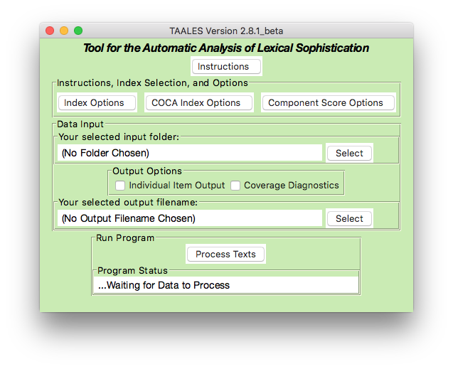
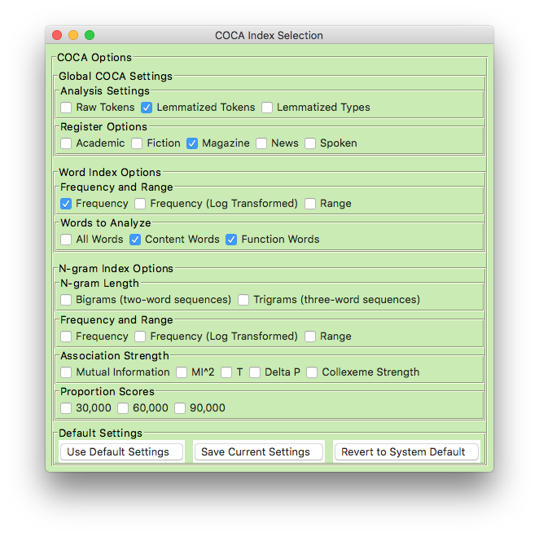

Slide 39
TAALES Processing Pipeline
A set of plain text files are stored in a folder
Files are copied into TAALES and are lemmatized and POS tagged
Each word in each text is assigned an index score (e.g., frequency)
An average index score is calculated for all words, content words, or function words
TAALES outputs a .csv spreadsheet with scores for each index for each text
If desired, TAALES also outputs an index coverage spreadsheet and word-level scores for each text

Slide 40
Limitations
No use of POS tagging
No use of dependency parsing
No use of semantic labeling
May or may not include lemmas
Some features may have lots of zero counts because of dictionary size
Handling ambiguous words
Misspellings
Language variation
Newer words

Slide 41
Our Context: ICNALE
International Corpus Network of Asian Learners of English
See ICNALE project for more information: http://language.sakura.ne.jp/icnale/
Spoken and written texts
Broad range of metadata
nationality
motivation
education background
CEFR proficiency (imputed in many cases)
Vocabulary Size Test (VST; Nation & Beglar, 2007) scores
Measured based on receptive vocabulary
We will focus on written texts and VST scores

Slide 42
TAALES, TAALED, ICNALE, & VST
For this analysis:
Data at: https://github.com/scrosseye/bonn_lexical_icnale
500 L2 writers from ICNALE
Texts with self-reported language proficiency scores (TOEFL, TOEIC, IELTS)
All texts have vocabulary size scores
Texts are a combination of two writing samples
Various L2 backgrounds
Mean (SD) words per essay: 228.5 (28.20)
Mean (SD) VST Score: 32.56 (9.73)
Do you agree or disagree with the following statement:
It is important for college students to have a part-time job.
Smoking should be banned from public places.
Our research question: What is the relationship between receptive vocabulary size and productive vocabulary use?

Slide 43
Some caveats here
We will just be hypothesis testing here
How well do selected indices perform
Correlate with VST score
We will not strictly control assumptions
This is just exploratory
We are focusing on r values and graphics
r value reflects size of relationship between two variables
VST and lexical measures
Graphics can show us relationships
There are many redundant indices in the tools
NLP is not always a less is more technique
SUBTLEXus_Freq_Log_CW_TAALES
COCA_magazine_lemma_frequency_Log_CW_TAALES
All_AWL_Normed
Brysbaert_Concreteness_Combined_CW
LD_Mean_RT_CW_TAALES
mattr50_aw_TAALED
hdd42_aw_TAALED
mtld_original_aw_TAALED

Slide 44
What is an r value?
Reported as part of a correlation
Test relationships between two quantitative variables
Do variables co-vary
Whether changes in one variable are met with similar changes in the other variable

Slide 45
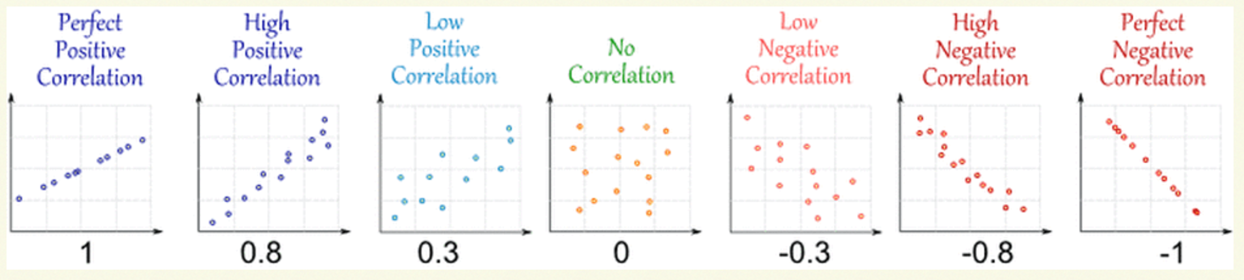
How to interpret a correlation
r is a calculation of effect size
r = .10 (small effect)
r = .30 (medium effect)
r = .50 (large effect)
These are scatterplots!

Slide 46
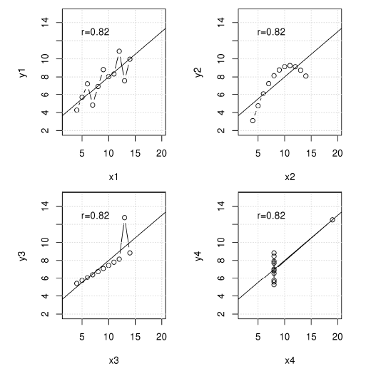
Linear relations?

Slide 47
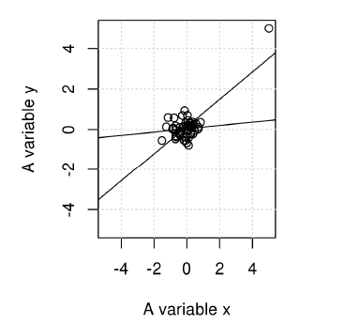
Outliers?
Without outlier, r = .100
With outlier, r = .75

Slide 48
TAALES Tutorial
Process data
Examine data
Preliminarily interpret results using JASP
Look at some word-level data
Discuss analyses

Slide 49
Your task
Pair off (or form small groups).
Develop a research question that is specific to a specific lexical property (or two)
Frequency
Concreteness
Phrasal counts
Etc…
Develop a hypothesis (i.e., what relationship will measures from your selected lexical property have with receptive vocabulary scores)
Collate your data
Run some simple correlations
Display some scatterplots
Be prepared to talk through your analyses

Slide 50

Discussion
What value do you see in NLP for the lexicon?
What specific lexical features are of interest to you?
What practical applications would you use lexical NLP for?
Are there uses for lexical NLP in the L2 classroom?
What is missing that would help you answer questions of interest to you?
What are some of the limitations of lexical NLP that you see?
How might you use this in your own work?
How can lexical NLP tools be used to further professional development?
Notes:
All

